Slide 1
CASA0011: Agent-Based Modelling
Dr Sarah WISE
Dr Thomas OLÉRON EVANS
s.wise@ucl.ac.uk
thomas.evans.11@ucl.ac.uk
Moodle password: ABM2022
Centre for Advanced
Spatial Analysis,
90 Tottenham Court Road

Slide 2
LECTURE 5 ABMs as Research Tools (So you have your model… What now?)

Slide 3
OBJECTIVES 1. Understand what needs to be considered when using an ABM as a research tool; 2. Understand techniques that can be used to find ‘optimal’ parameter values for an ABM.

Slide 4
Course Objectives
You should...
1. understand the principles of
agent-based modelling (ABM).
2. be able to describe the type and range of systems to which ABM can be profitably and appropriately applied.
3. be able to conceptualise and model
urban systems with complex dynamics.
4. show evidence of being able to translate your
understanding into the practical methodology of modelling

Slide 5
The ABM Course
Week 1: Introduction to ABMs
Week 2: Cellular Automata
Week 3: ABM Methodology
Week 4: Agent Behaviours
Week 5: ABMs as Research Tools
READING WEEK
Week 6: Testing ABMs / Presenting Results
Week 7:
Week 8: Forecasting & Prediction
Week 9: Traffic Modelling
Week 10:

Slide 6
Coursework II

Slide 7
ABMs as a Research Tool What to measure?
Key Questions
What is your research question…?
… so what are you trying to do?
… so what metrics are relevant to you?
… so what data do you need to record from your model?
… and when do you need to record it? (i.e. At the end? After every iteration? At key moments?)
Must be part of your thought process very early on!

Slide 8
ABMs as a Research Tool What to measure?
“… it is difficult to bring mathematical analysis tools to bear [on ABMs]…”
Hinkelmann et al (2011)
Need for creative metrics
(e.g. ‘corridor width’)

Slide 9
ABMs as a Research Tool Two broad approaches
Analytical heuristics (ABM specific approaches)
Systematic Experimentation (More traditional approach)

Slide 10
1. Analytical Heuristics Railsback & Grimm (2011)
Examine behaviour of model for extreme parameter values;
Find “tipping points” in emergent behaviour;
Visualise the model in different ways;
Step through simulation iteration by iteration to understand causal mechanisms driving observed behaviour;
Identify interesting/unusual patterns in observed behaviour;

Slide 11
1. Analytical Heuristics Railsback & Grimm (2011)
Fix parameters at “interesting” values vary others;
Use different “currencies” to evaluate model outcomes;
Analyse simplified versions of a model;
Study a model from the ‘bottom up’: Individuals → Relationships → Complete System;
Consider unrealistic scenarios or parameter values: Which realistic features are necessary to produce observed behaviour? Which could be neglected?

Slide 12
1. Analytical Heuristics Railsback & Grimm (2011)
Fix parameters at “interesting” values vary others;
Use different “currencies” to evaluate model outcomes;
Analyse simplified versions of a model;
Study a model from the `bottom up’: Individuals → Relationships → Complete System;
Consider unrealistic scenarios or parameter values: Which realistic features are necessary to produce observed behaviour? Which could be neglected?
global statistical quantities
parameters of best-fit statistical distributions
statistics derived from time series
spatial statistics
measures of heterogeneity between agents
properties related to model stability (e.g. time to return to equilibrium after perturbation)

Slide 13
1. Analytical Heuristics Railsback & Grimm (2011)
POTENTIAL OBJECTIVES
Gain a broad & deep understanding of model behaviour;
Play with model before developing a formal experimental methodology;
Provide ideas for useful metrics to study;
BUT… can be developed into a complete piece of research.

Slide 14
‘Warm-Up’ Period

Slide 15
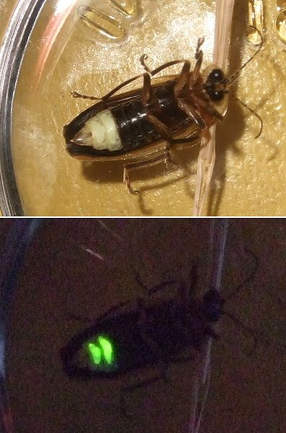
‘Warm-Up’ Period
https://www.youtube.com/watch?v=sROKYelaWbo
https://commons.wikimedia.org/wiki/File:Firefly_composite.jpg

Slide 16
‘Warm-Up’ Period
https://www.youtube.com/watch?v=ZGvtnE1Wy6U

Slide 17
‘Warm-Up’ Period
All Possible States
-
‘Warm
Up’
‘Natural’ States
Initial Conditions

Slide 18
‘Warm-Up’ Period
Behaviour driven by the initial conditions;
Does not represent stable/long-term behaviour of the model.
KEY QUESTION Are you interested in…
‘Warm-up’ period / ‘Natural’ behaviour of the system / Both?
Identify length of warm-up period (through exploration & visualisation);
Start / Stop gathering data after this period.

Slide 19
2. Systematic Experimentation
POTENTIAL OBJECTIVES
Develop a systematic picture of model behaviour;
Use the model to ‘optimise’ a particular metric.

Slide 20
2. Systematic Experimentation
STEP ONE
Define the parameter space

Slide 21
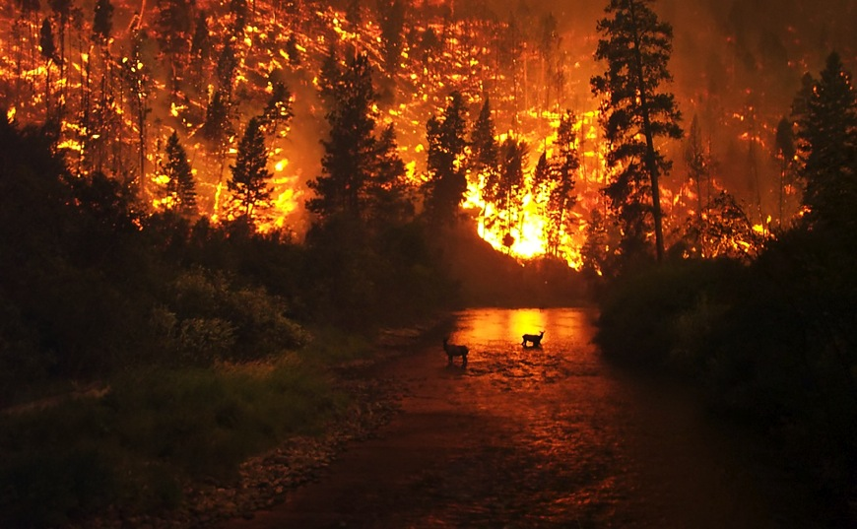

Slide 22
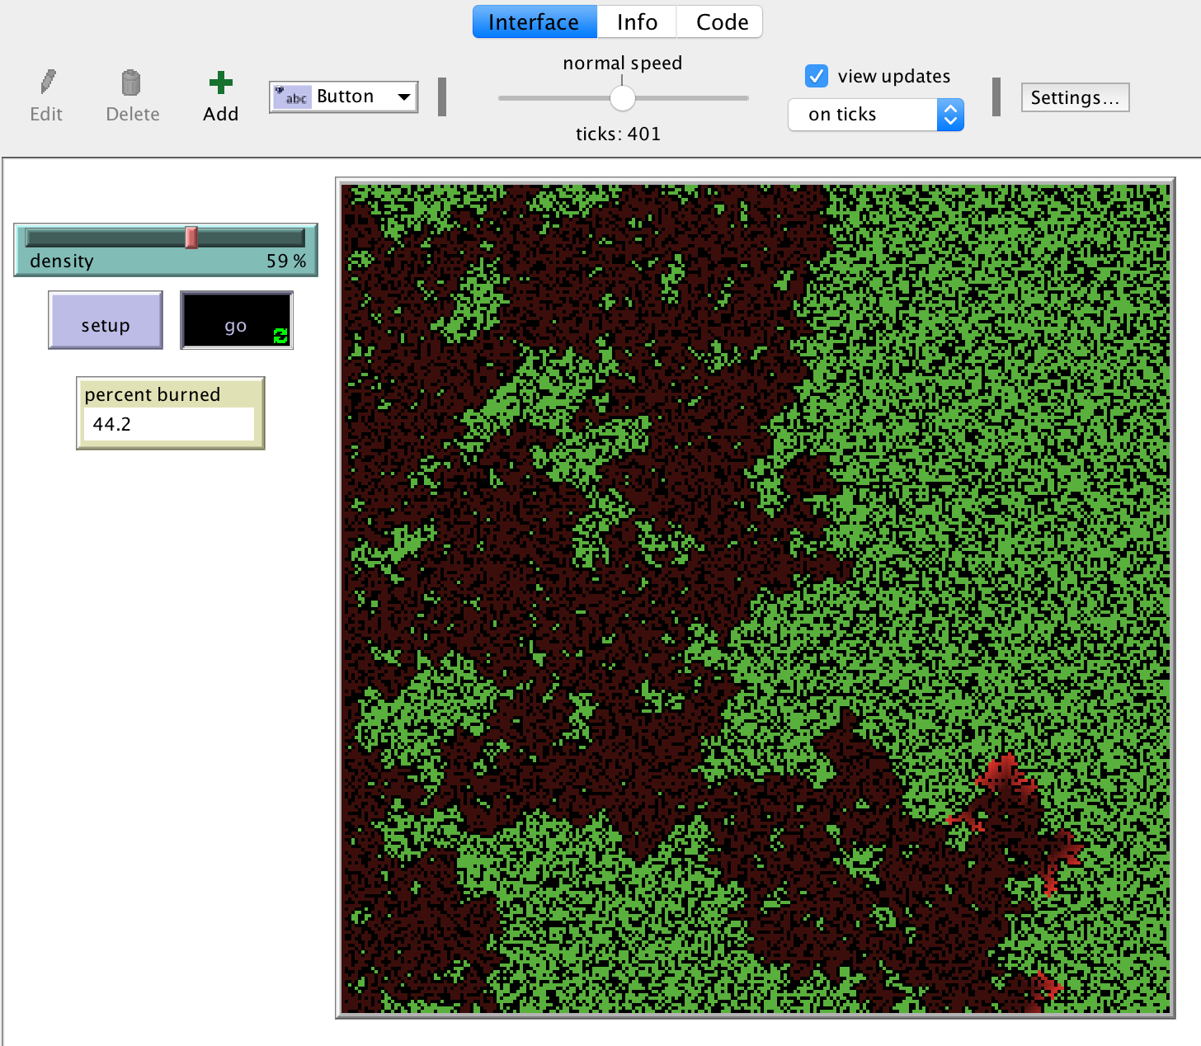

Slide 23

‘Horizontal’ Deforestation

Slide 24
Finding the optimal deforestation pattern
A Systematic Approach

Slide 25
Determine the Parameters
X =
Density of Forest
Y =
Proportion
of Squares Deforested

Slide 26
Y
Proportion
of Squares Deforested
Parameter
Space
Density of Forest
X

Slide 27
2. Systematic Experimentation
STEP TWO (a)
Systematic Search
Metric of Interest:
Proportion of Surviving Trees (= Final Trees / Initial Trees)

Slide 28
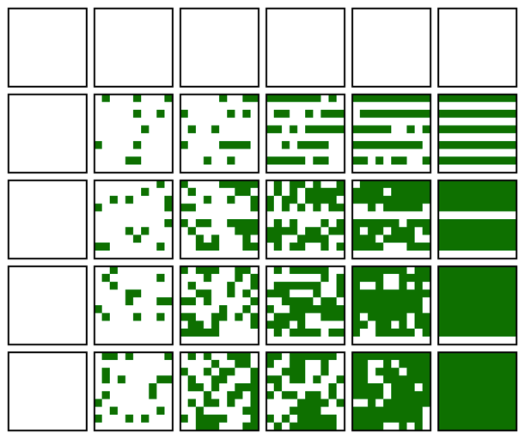
Proportion
of Squares Deforested
1
0.5
0.2
0.1
0
0
0.2
0.4
0.6
0.8
1
Density of Forest

Slide 29
Y
Proportion
of Squares Deforested
Density of Forest
“Systematic Search”
X
Notes:
Random – run many times - replicates

Slide 30
2. Systematic Experimentation
STEP TWO (b)
Optimisation Techniques

Slide 31
Y
Proportion
of Squares Deforested
Density of Forest
“Systematic Search”
X

Slide 32
Summary
Exploratory analysis – Analytical heuristics;
What metrics are relevant?
Concept of ‘warm-up’ period;
Systematic search of parameter space;
Optimisation Techniques

Slide 33
BehaviorSpace

Slide 34
OBJECTIVES 1. Understand what needs to be considered when using an ABM as a research tool; 2. Understand techniques that can be used to find ‘optimal’ parameter values for an ABM.

Slide 35
Bibliography ABM Lecture V
Gilbert, N., 2008. Agent-Based Models. No. 153 in Quantitative Applications in the Social Sciences. SAGE Publications, Thousand Oaks, USA.
Hinkelmann, F., Murrugarra, D., Salam Jarrah, A., Laubenbacher, R., Jul 2011. A mathematical framework for agent based models of complex biological networks. Bulletin of Mathematical Biology 73 (7), 1583-1602.
Railsback, S. F., Grimm, V., 2012. Agent-Based and Individual-Based Modeling: A Practical Introduction. Princeton University Press, Princeton, USA.
Kirkpatrick, S., Gelatt Jr, C. D., Vecchi, M. P., 1983. "Optimization by Simulated Annealing". Science. 220 (4598): 671–680.
Oléron Evans, T. P. , 2015. “Perspectives on the relationship between local interactions and global outcomes in spatially explicit models of systems of interacting individuals” [Doctoral Thesis], University College London

Slide 36
CASA0011: Agent-Based Modelling
Dr Sarah WISE
Dr Thomas OLÉRON EVANS
s.wise@ucl.ac.uk
thomas.evans.11@ucl.ac.uk
Moodle password: ABM20
Centre for Advanced
Spatial Analysis,
90 Tottenham Court Road

